Slide 1


Slide 2


Slide 3


Slide 4
MEXICO
This entry briefly describes the type of economy, including the degree of market orientation, the level of economic development, the most important natural resources, and the unique areas of specialization. It also characterizes major economic events and policy changes in the most recent 12 months and may include a statement about one or two key future macroeconomic trends. Economy - overview field listing
Mexico's $2.4 trillion economy – 11th largest in the world - has become increasingly oriented toward manufacturing since the North American Free Trade Agreement (NAFTA) entered into force in 1994. Per capita income is roughly one-third that of the US; income distribution remains highly unequal.
Mexico has become the US' second-largest export market and third-largest source of imports. In 2017, two-way trade in goods and services exceeded $623 billion. Mexico has free trade agreements with 46 countries, putting more than 90% of its trade under free trade agreements. In 2012, Mexico formed the Pacific Alliance with Peru, Colombia, and Chile.
Mexico's current government, led by President Enrique PEÑA NIETO, has emphasized economic reforms, passing and implementing sweeping energy, financial, fiscal, and telecommunications reform legislation, among others, with the long-term aim to improve competitiveness and economic growth across the Mexican economy. Since 2015, Mexico has held public auctions of oil and gas exploration and development rights and for long-term electric power generation contracts. Mexico has also issued permits for private sector import, distribution, and retail sales of refined petroleum products in an effort to attract private investment into the energy sector and boost production.
Since 2013, Mexico’s economic growth has averaged 2% annually, falling short of private-sector expectations that President PEÑA NIETO’s sweeping reforms would bolster economic prospects. Growth is predicted to remain below potential given falling oil production, weak oil prices, structural issues such as low productivity, high inequality, a large informal sector employing over half of the workforce, weak rule of law, and corruption. Mexico’s economy remains vulnerable to uncertainty surrounding the future of NAFTA — because the United States is its top trading partner and the two countries share integrated supply chains — and to potential shifts in domestic policies following the inauguration of a new a president in December 2018.

Slide 5
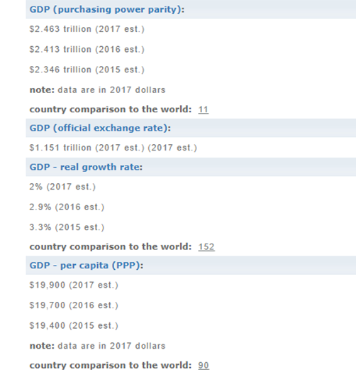
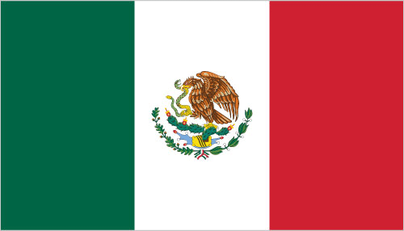
MEXICO
Population: 125,959,205 (July 2018 est.)
country comparison to the world: 11

Slide 6
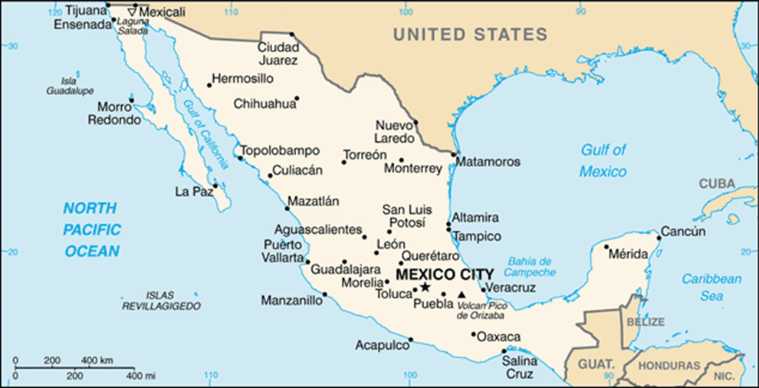
MEXICO

Slide 7
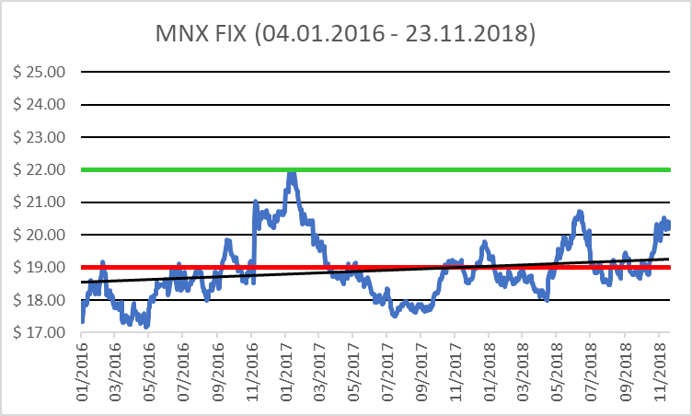
MEXICO

Slide 8
COLOMBIA
Colombia heavily depends on energy and mining exports, making it vulnerable to fluctuations in commodity prices. Colombia is Latin America’s fourth largest oil producer and the world’s fourth largest coal producer, third largest coffee exporter, and second largest cut flowers exporter. Colombia’s economic development is hampered by inadequate infrastructure, poverty, narcotrafficking, and an uncertain security situation, in addition to dependence on primary commodities (goods that have little value-added from processing or labor inputs).
Colombia’s economy slowed in 2017 because of falling world market prices for oil and lower domestic oil production due to insurgent attacks on pipeline infrastructure. Although real GDP growth averaged 4.7% during the past decade, it fell to an estimated 1.8% in 2017. Declining oil prices also have contributed to reduced government revenues. In 2016, oil revenue dropped below 4% of the federal budget and likely remained below 4% in 2017. A Western credit rating agency in December 2017 downgraded Colombia’s sovereign credit rating to BBB-, because of weaker-than-expected growth and increasing external debt. Colombia has struggled to address local referendums against foreign investment, which have slowed its expansion, especially in the oil and mining sectors. Colombia’s FDI declined by 3% to $10.2 billion between January and September 2017.
Colombia has signed or is negotiating Free Trade Agreements (FTA) with more than a dozen countries; the US-Colombia FTA went into effect in May 2012. Colombia is a founding member of the Pacific Alliance—a regional trade block formed in 2012 by Chile, Colombia, Mexico, and Peru to promote regional trade and economic integration. The Colombian government took steps in 2017 to address several bilateral trade irritants with the US, including those on truck scrappage, distilled spirits, pharmaceuticals, ethanol imports, and labor rights. Colombia hopes to accede to the Organization for Economic Cooperation and Development.

Slide 9
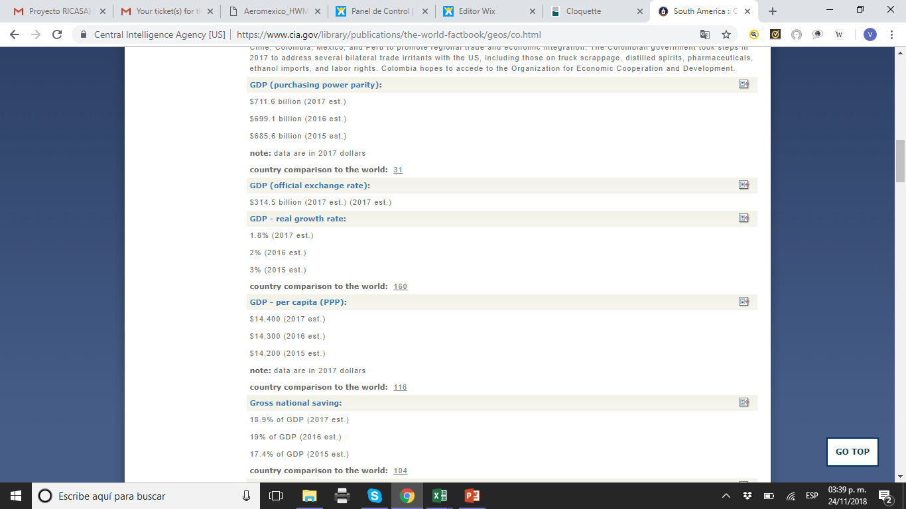
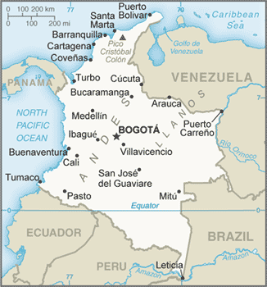

COLOMBIA
Population: 48,168,996 (July 2018 est.)
country comparison to the world: 30

Slide 10
GUATEMALA
Guatemala is the most populous country in Central America with a GDP per capita roughly half the average for Latin America and the Caribbean. The agricultural sector accounts for 13.5% of GDP and 31% of the labor force; key agricultural exports include sugar, coffee, bananas, and vegetables. Guatemala is the top remittance recipient in Central America as a result of Guatemala's large expatriate community in the US. These inflows are a primary source of foreign income, equivalent to two-thirds of the country's exports and about a tenth of its GDP.
The 1996 peace accords, which ended 36 years of civil war, removed a major obstacle to foreign investment, and Guatemala has since pursued important reforms and macroeconomic stabilization. The Dominican Republic-Central America Free Trade Agreement (CAFTA-DR) entered into force in July 2006, spurring increased investment and diversification of exports, with the largest increases in ethanol and non-traditional agricultural exports. While CAFTA-DR has helped improve the investment climate, concerns over security, the lack of skilled workers, and poor infrastructure continue to hamper foreign direct investment.
The distribution of income remains highly unequal with the richest 20% of the population accounting for more than 51% of Guatemala's overall consumption. More than half of the population is below the national poverty line, and 23% of the population lives in extreme poverty. Poverty among indigenous groups, which make up more than 40% of the population, averages 79%, with 40% of the indigenous population living in extreme poverty. Nearly one-half of Guatemala's children under age five are chronically malnourished, one of the highest malnutrition rates in the world.

Slide 11
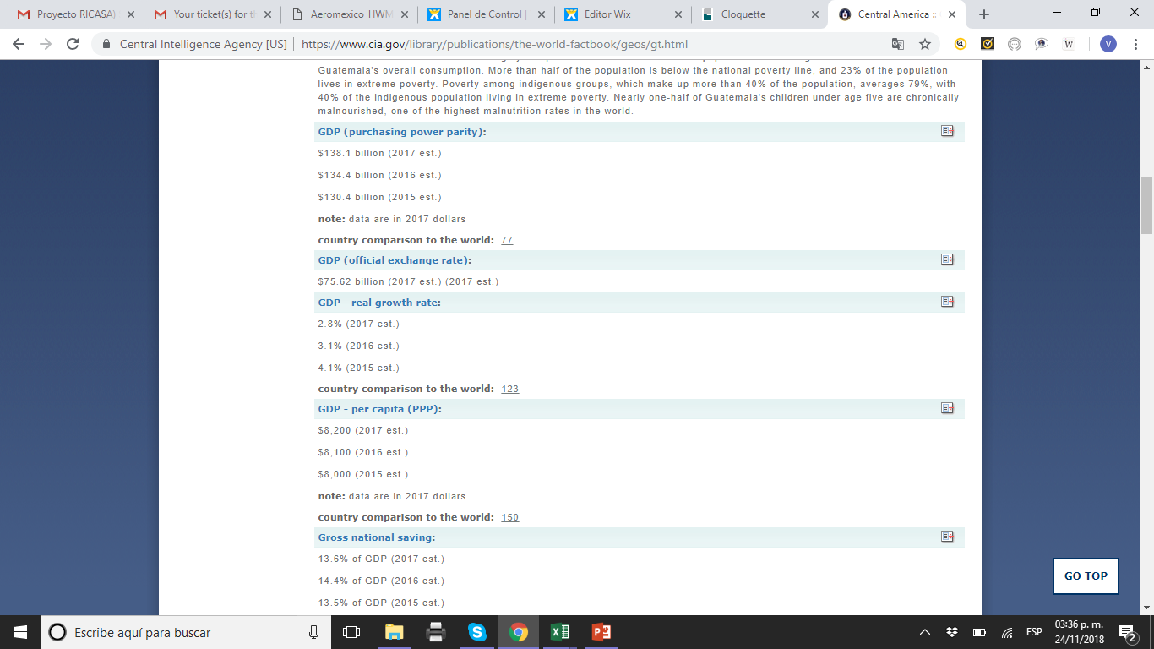
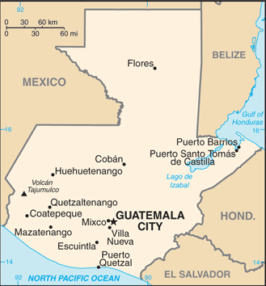
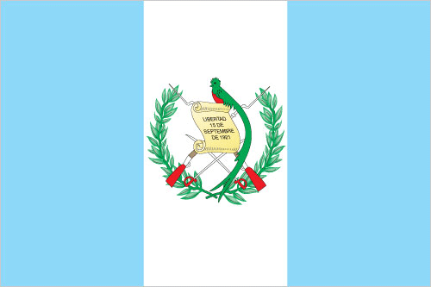
GUATEMALA
Population: 16,581,273 (July 2018 est.)
country comparison to the world: 67

Slide 12
EL SALVADOR
The smallest country in Central America geographically, El Salvador has the fourth largest economy in the region. With the global recession, real GDP contracted in 2009 and economic growth has since remained low, averaging less than 2% from 2010 to 2014, but recovered somewhat in 2015-17 with an average annual growth rate of 2.4%. Remittances accounted for approximately 18% of GDP in 2017 and were received by about a third of all households.
In 2006, El Salvador was the first country to ratify the Dominican Republic-Central American Free Trade Agreement, which has bolstered the export of processed foods, sugar, and ethanol, and supported investment in the apparel sector amid increased Asian competition. In September 2015, El Salvador kicked off a five-year $277 million second compact with the Millennium Challenge Corporation - a US Government agency aimed at stimulating economic growth and reducing poverty - to improve El Salvador's competitiveness and productivity in international markets.
The Salvadoran Government maintained fiscal discipline during reconstruction and rebuilding following earthquakes in 2001 and hurricanes in 1998 and 2005, but El Salvador's public debt, estimated at 59.3% of GDP in 2017, has been growing over the last several years.

Slide 13
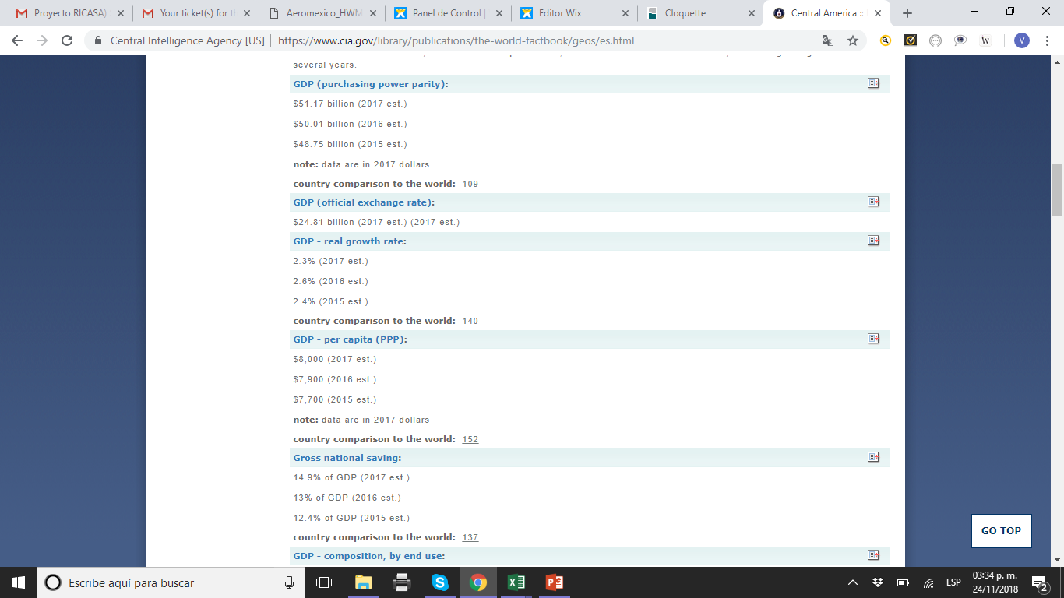
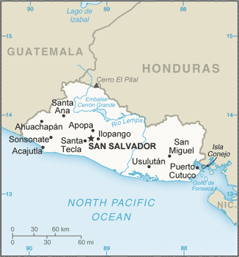
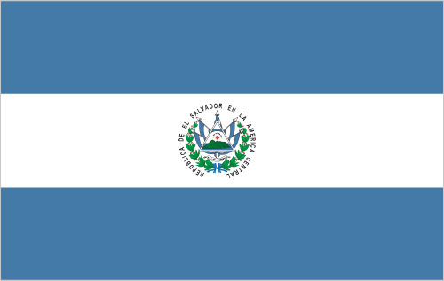
EL SALVADOR
Population: 6,187,271 (July 2018 est.)
country comparison to the world: 109

Slide 14
NICARAGUA
Nicaragua, the poorest country in Central America and the second poorest in the Western Hemisphere, has widespread underemployment and poverty. GDP growth of 4.5% in 2017 was insufficient to make a significant difference. Textiles and agriculture combined account for nearly 50% of Nicaragua's exports. Beef, coffee, and gold are Nicaragua’s top three export commodities.
The Dominican Republic-Central America-United States Free Trade Agreement has been in effect since April 2006 and has expanded export opportunities for many Nicaraguan agricultural and manufactured goods.
In 2013, the government granted a 50-year concession with the option for an additional 50 years to a newly formed Chinese-run company to finance and build an inter-oceanic canal and related projects, at an estimated cost of $50 billion. The canal construction has not started.

Slide 15
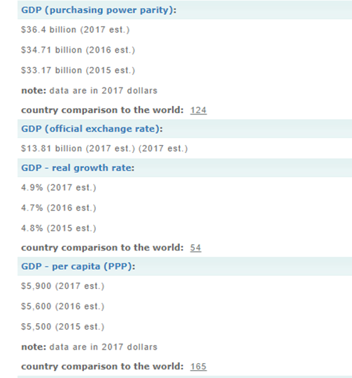
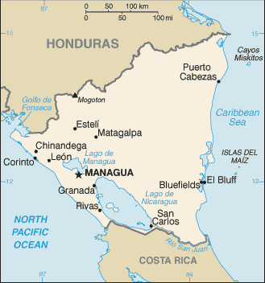
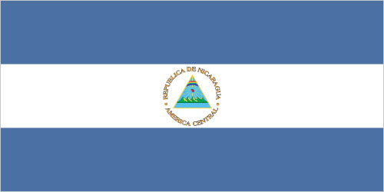
NICARAGUA
Population: 6,085,213 (July 2018 est.)
country comparison to the world: 111

Slide 16
HONDURAS
Honduras, the second poorest country in Central America, suffers from extraordinarily unequal distribution of income, as well as high underemployment. While historically dependent on the export of bananas and coffee, Honduras has diversified its export base to include apparel and automobile wire harnessing.
Honduras’s economy depends heavily on US trade and remittances. The US-Central America-Dominican Republic Free Trade Agreement came into force in 2006 and has helped foster foreign direct investment, but physical and political insecurity, as well as crime and perceptions of corruption, may deter potential investors; about 15% of foreign direct investment is from US firms.
The economy registered modest economic growth of 3.1%-4.0% from 2010 to 2017, insufficient to improve living standards for the nearly 65% of the population in poverty. In 2017, Honduras faced rising public debt, but its economy has performed better than expected due to low oil prices and improved investor confidence. Honduras signed a three-year standby arrangement with the IMF in December 2014, aimed at easing Honduras’s poor fiscal position.

Slide 17
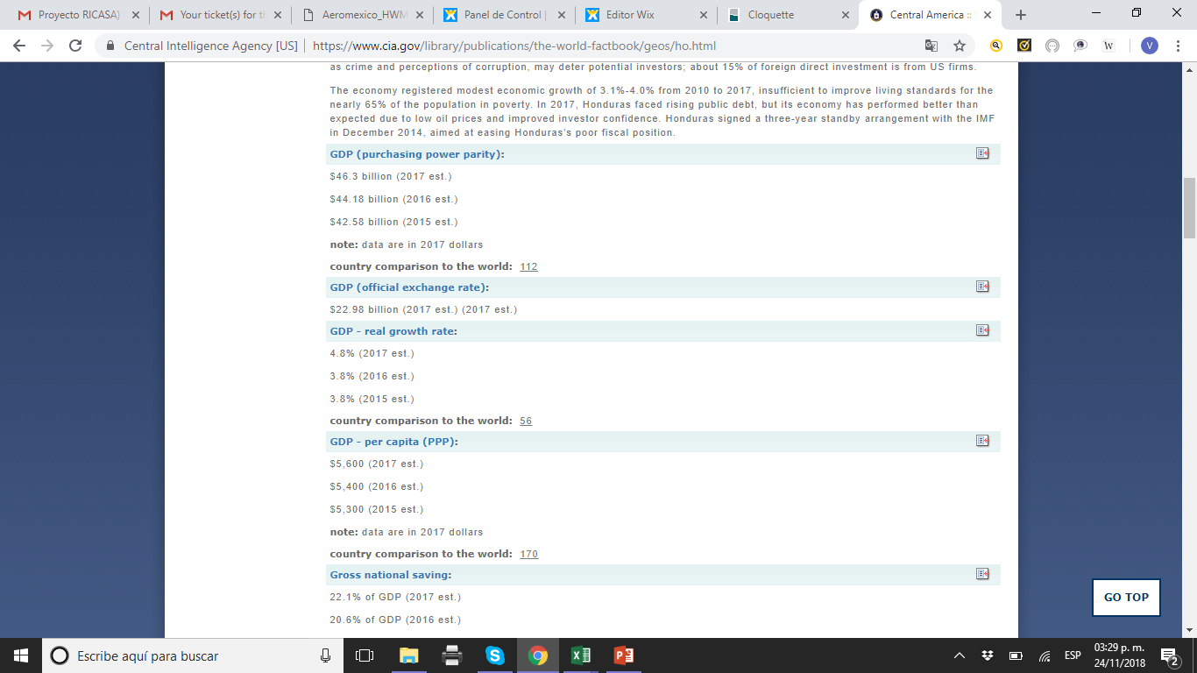
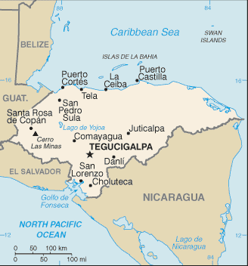
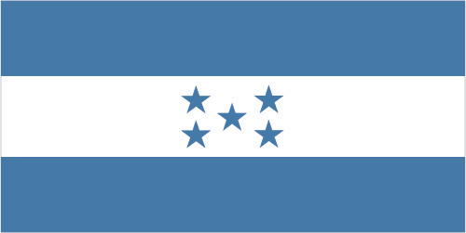
HONDURAS
Population: 9,182,766 (July 2018 est.)
country comparison to the world: 95

Slide 18
COSTA RICA
Since 2010, Costa Rica has enjoyed strong and stable economic growth - 3.8% in 2017. Exports of bananas, coffee, sugar, and beef are the backbone of its commodity exports. Various industrial and processed agricultural products have broadened exports in recent years, as have high value-added goods, including medical devices. Costa Rica's impressive biodiversity also makes it a key destination for ecotourism.
Foreign investors remain attracted by the country's political stability and relatively high education levels, as well as the incentives offered in the free-trade zones; Costa Rica has attracted one of the highest levels of foreign direct investment per capita in Latin America. The US-Central American-Dominican Republic Free Trade Agreement (CAFTA-DR), which became effective for Costa Rica in 2009, helped increase foreign direct investment in key sectors of the economy, including insurance and telecommunication. However, poor infrastructure, high energy costs, a complex bureaucracy, weak investor protection, and uncertainty of contract enforcement impede greater investment.
Costa Rica’s economy also faces challenges due to a rising fiscal deficit, rising public debt, and relatively low levels of domestic revenue. Poverty has remained around 20-25% for nearly 20 years, and the government’s strong social safety net has eroded due to increased constraints on its expenditures. Costa Rica’s credit rating was downgraded from stable to negative in 2015 and again in 2017, upping pressure on lending rates - which could hurt small business, on the budget deficit - which could hurt infrastructure development, and on the rate of return on investment - which could soften foreign direct investment (FDI). Unlike the rest of Central America, Costa Rica is not highly dependent on remittances - which represented just 1 % of GDP in 2016, but instead relies on FDI - which accounted for 5.1% of GDP.

Slide 19
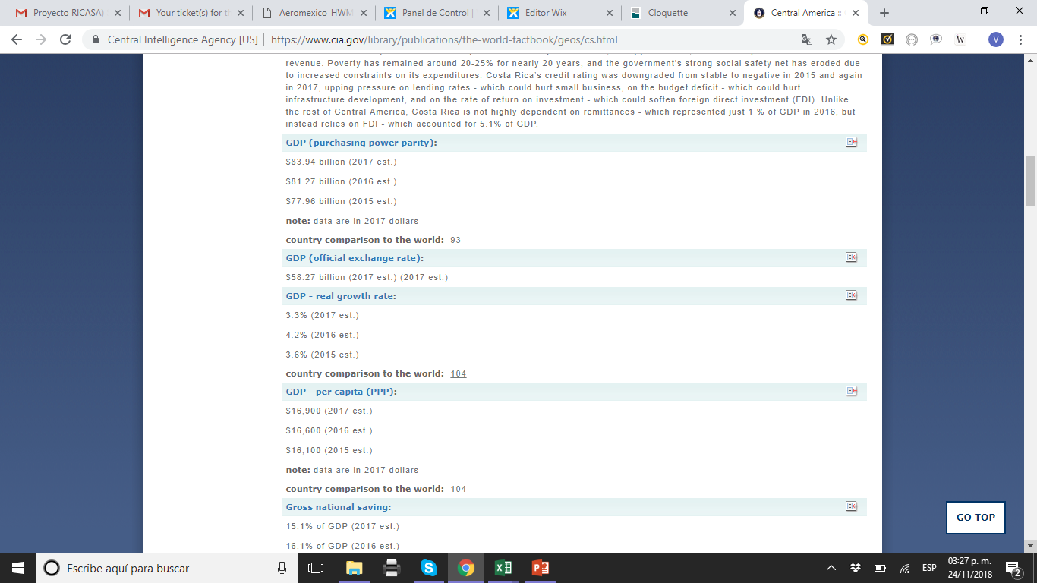
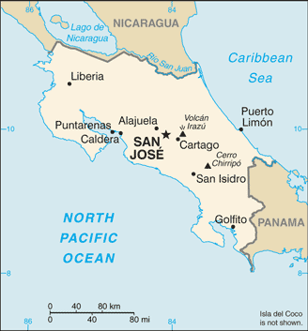
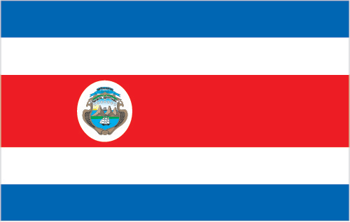
COSTA RICA
Population: 4,987,142 (July 2018 est.)
country comparison to the world: 123

Slide 20
PANAMA
Panama's dollar-based economy rests primarily on a well-developed services sector that accounts for more than three-quarters of GDP. Services include operating the Panama Canal, logistics, banking, the Colon Free Trade Zone, insurance, container ports, flagship registry, and tourism and Panama is a center for offshore banking. Panama's transportation and logistics services sectors, along with infrastructure development projects, have boosted economic growth; however, public debt surpassed $37 billion in 2016 because of excessive government spending and public works projects. The US-Panama Trade Promotion Agreement was approved by Congress and signed into law in October 2011, and entered into force in October 2012.
Future growth will be bolstered by the Panama Canal expansion project that began in 2007 and was completed in 2016 at a cost of $5.3 billion - about 10-15% of current GDP. The expansion project more than doubled the Canal's capacity, enabling it to accommodate high-capacity vessels such as tankers and neopanamax vessels that are too large to traverse the existing canal. The US and China are the top users of the Canal.
Strong economic performance has not translated into broadly shared prosperity, as Panama has the second worst income distribution in Latin America. About one-fourth of the population lives in poverty; however, from 2006 to 2012 poverty was reduced by 10 percentage points.

Slide 21
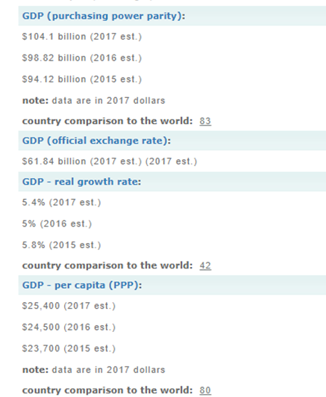
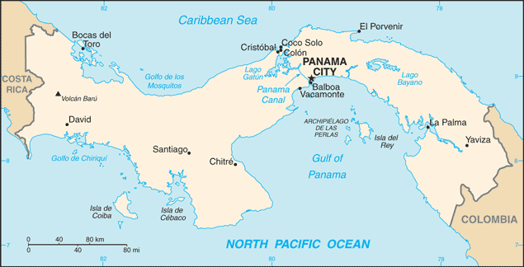
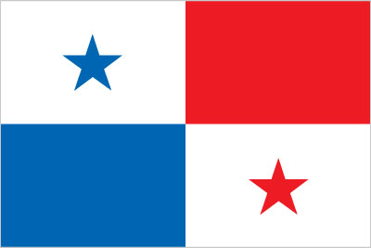
PANAMA
Population: 3,800,644 (July 2018 est.)
country comparison to the world: 130

Slide 22
BELIZE
Tourism is the number one foreign exchange earner in this small economy, followed by exports of sugar, bananas, citrus, marine products, and crude oil.
The government's expansionary monetary and fiscal policies, initiated in September 1998, led to GDP growth averaging nearly 4% in 1999-2007, but GPD growth has averaged only 2.1% from 2007-2016, with 2.5% growth estimated for 2017. Belize’s dependence on energy imports makes it susceptible to energy price shocks.
Although Belize has the third highest per capita income in Central America, the average income figure masks a huge income disparity between rich and poor, and a key government objective remains reducing poverty and inequality with the help of international donors. High unemployment, a growing trade deficit and heavy foreign debt burden continue to be major concerns. Belize faces continued pressure from rising sovereign debt, and a growing trade imbalance.

Slide 23
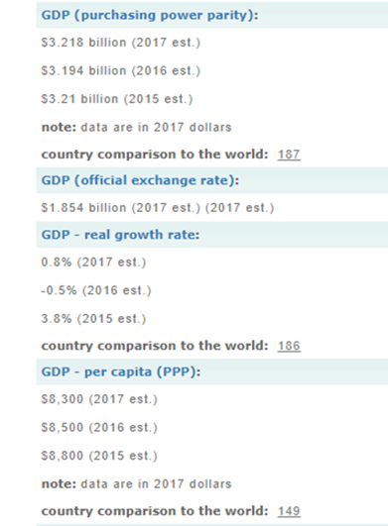
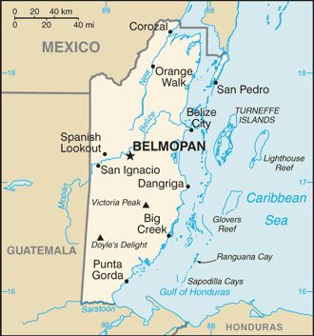
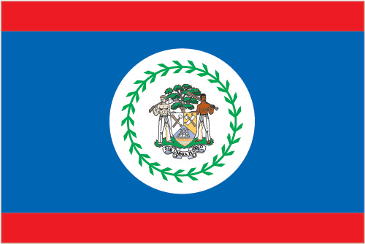
BELIZE
Population: 385,854 (July 2018 est.)
country comparison to the world: 177

Slide 24
DOMINICAN REPUBLIC
The Dominican Republic was for most of its history primarily an exporter of sugar, coffee, and tobacco, but over the last three decades the economy has become more diversified as the service sector has overtaken agriculture as the economy's largest employer, due to growth in construction, tourism, and free trade zones. The mining sector has also played a greater role in the export market since late 2012 with the commencement of the extraction phase of the Pueblo Viejo Gold and Silver mine, one of the largest gold mines in the world.
For the last 20 years, the Dominican Republic has been one of the fastest growing economies in Latin America. The economy rebounded from the global recession in 2010-16, and the fiscal situation is improving. A tax reform package passed in November 2012, a reduction in government spending, and lower energy costs helped to narrow the central government budget deficit from 6.6% of GDP in 2012 to 2.6% in 2016, and public debt is declining. Marked income inequality, high unemployment, and underemployment remain important long-term challenges; the poorest half of the population receives less than one-fifth of GDP, while the richest 10% enjoys nearly 40% of GDP.
The economy is highly dependent upon the US, the destination for approximately half of exports and the source of 40% of imports. Remittances from the US amount to about 7% of GDP, equivalent to about a third of exports and two-thirds of tourism receipts. The Central America-Dominican Republic Free Trade Agreement came into force in March 2007, boosting investment and manufacturing exports.

Slide 25
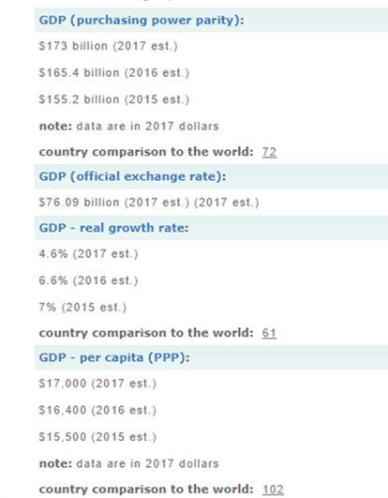
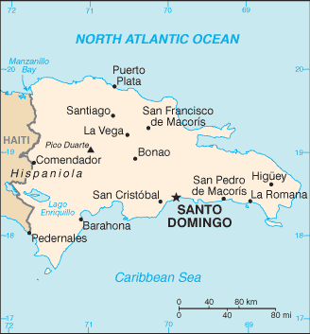

DOMINICAN REPUBLIC
Population: 10,298,756 (July 2018 est.)
country comparison to the world: 88

